Slide 1
What is an Evolutionary Algorithm?
Chapter 2

Slide 2
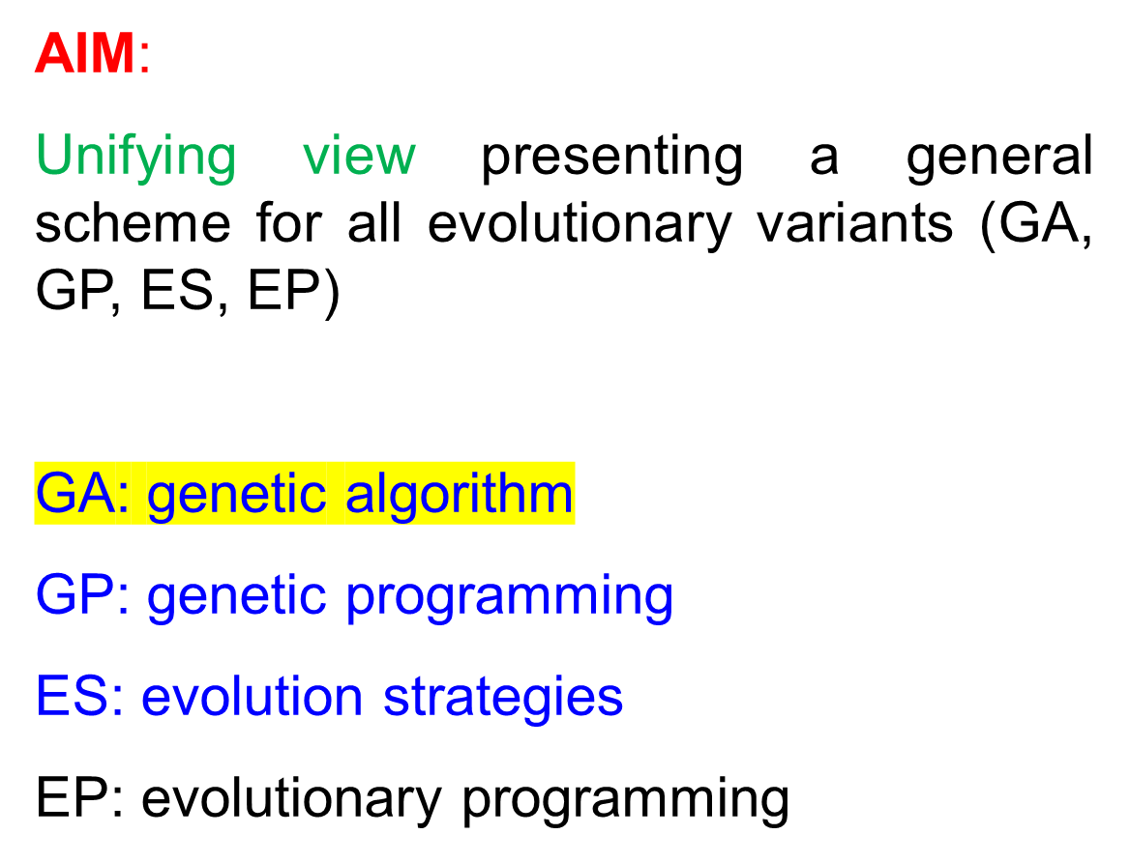

Slide 3
Contents
Recap (扼要重述) of Evolutionary Metaphor
Basic scheme of an EA
Basic Components:
  Representation / Evaluation / Population / Parent Selection / Recombination / Mutation / Survivor Selection / Termination
Examples : eight queens
Typical behaviours of EAs
EC in context of global optimisation

Slide 4
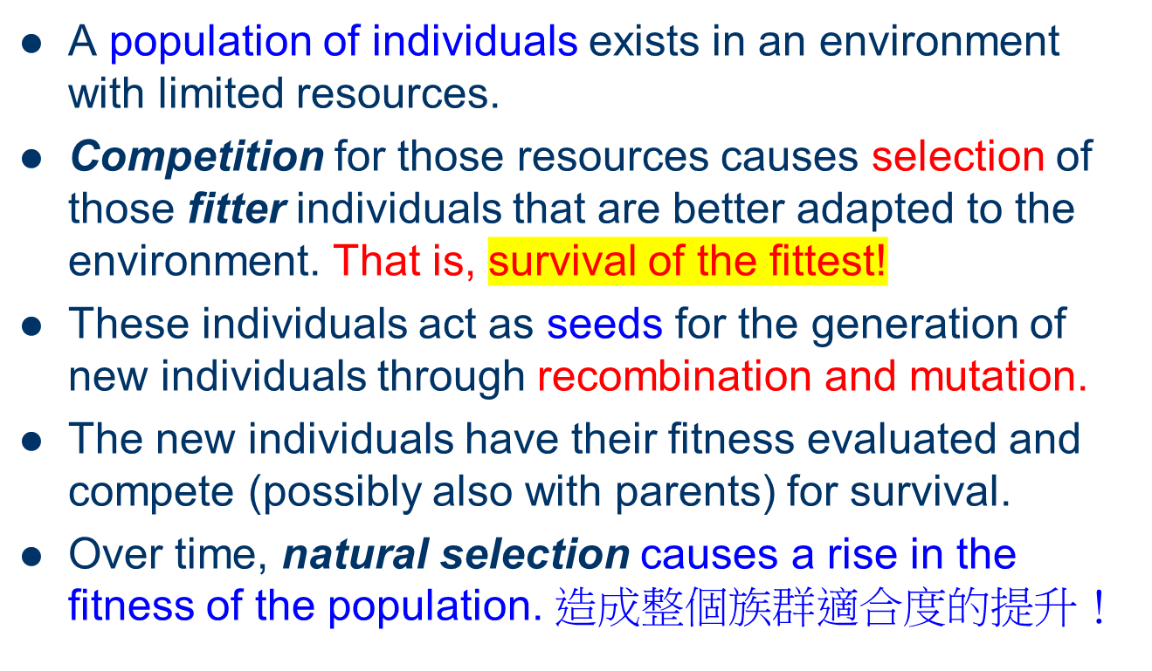
Recap of Evolutionary Metaphor

Slide 5
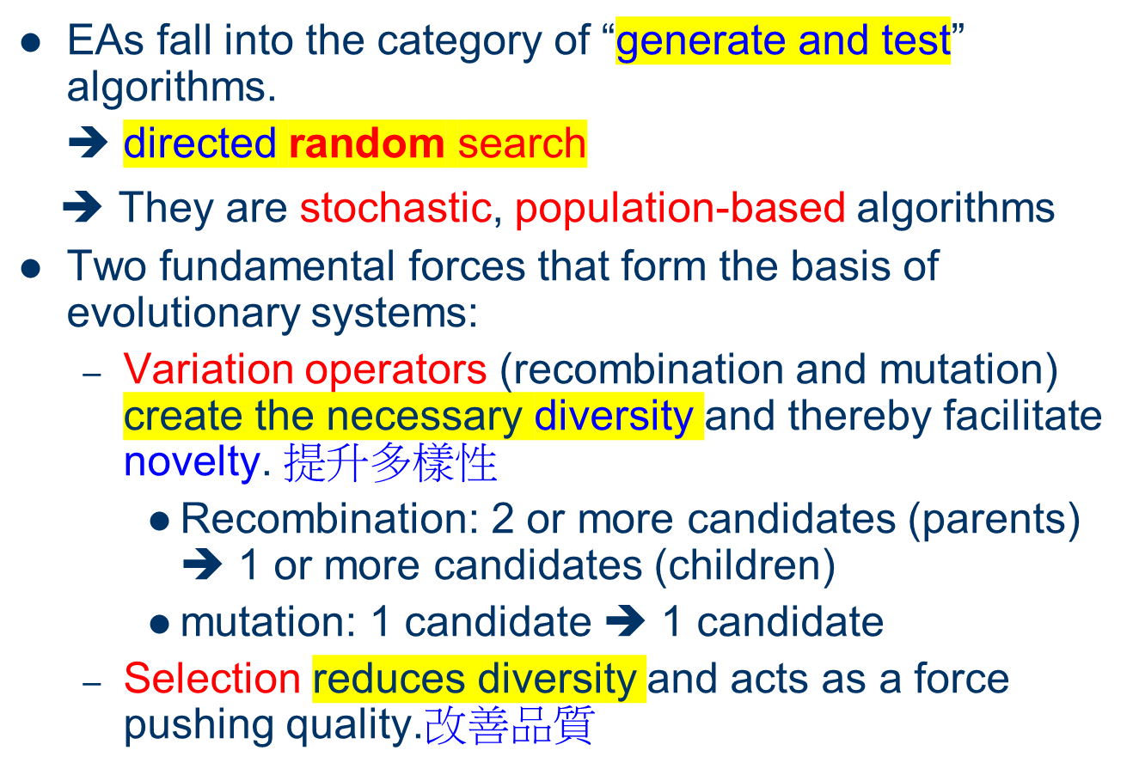
Recap 2:

Slide 6
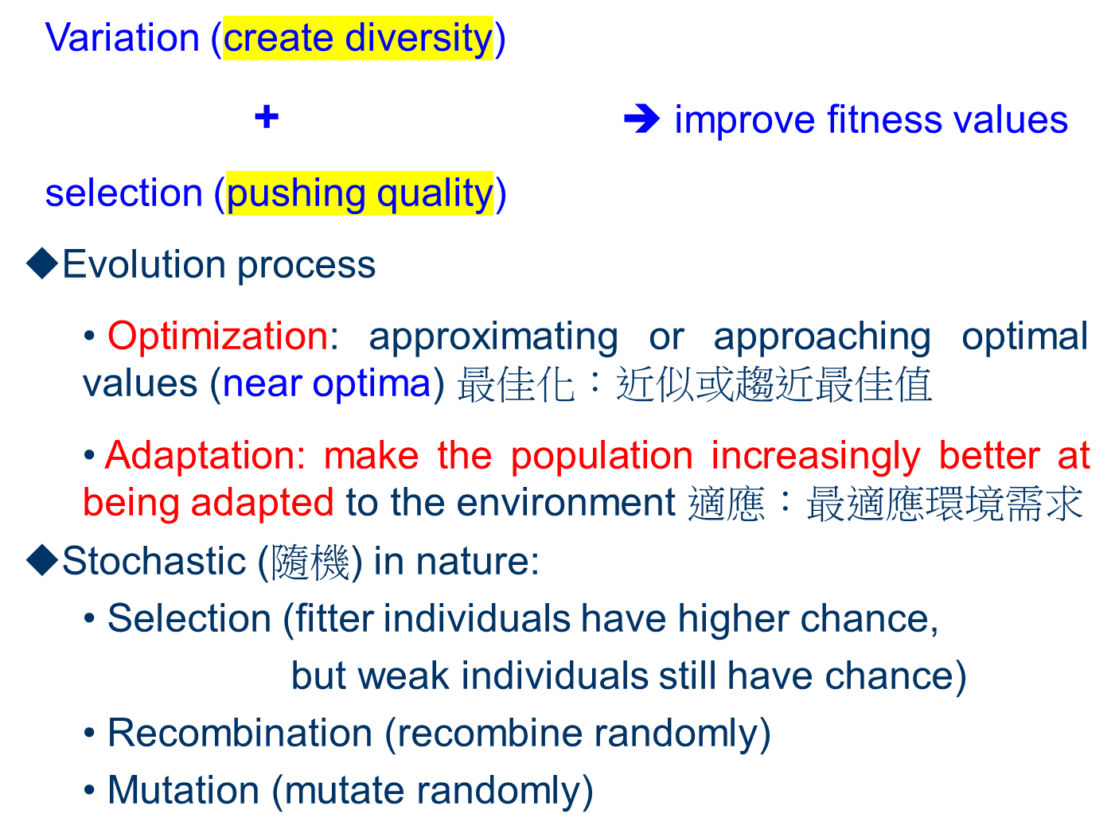

Slide 7
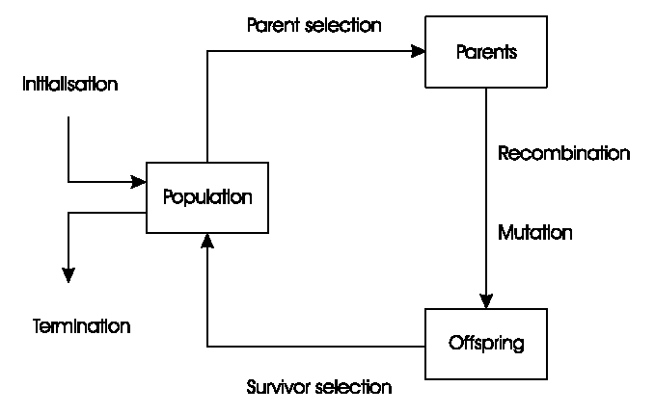
General Scheme of EAs

Slide 8
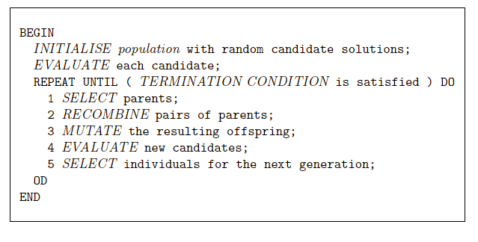
Pseudo-code for a typical EA
random?
➔ Search process is driven by the variation and selection operators!

Slide 9
What are the different types of EAs
Historically different flavours of EAs have been associated with different representations
  Strings (binary, integer, permutation (排列), etc.) : Genetic Algorithms
  Real-valued vectors : Evolution Strategies
  Finite state Machines: Evolutionary Programming
  (LISP) trees: Genetic Programming
However, a given representation is preferable over others if matches the problem better.編碼方式應與問題直接對應 (較直接!)

Slide 10
What are the different types of EAs
Best strategy:
  choose representation to suit specific problems
  Make encoding of solutions easier or more natural
  EX: TSP (traveling salesman problem) ➔ permutation 排列
  EX: Logic circuit design ➔ tree
  EX: Computer program to play checker (棋)➔ tree
  EX: Modeling (system ID)➔ string / real-valued vector
choose variation operators to suit representation
  i.e., Suitable operators for different representation
Selection operators only use fitness and so are independent of representation

Slide 11
Components of EAs
Representation (definition of individuals)
Evaluation function (fitness function)
Population
Parent selection mechanism
Variation operator
Survivor selection mechanism (replacement)
Initialization
Termination conditions

Slide 12
Representations (definition of individuals)
➔ link the real-world to the EA world!
Candidate solutions (individuals) exist in phenotype space
  Possible solution to the original problem
  Candidate solution; phenotype; individual;
They are encoded in chromosomes, which exist in genotype space
  Evolutionary search actually takes place
  Chromosome; individual
Encoding : phenotype => genotype (not necessarily one to one)
Decoding : genotype => phenotype (must be one to one)
Chromosomes contain genes, which are in (usually fixed) positions called locus (variable, position) and have a value (allele)
In order to find the global optimum, every feasible solution must be represented in genotype space
Notes:
Whilst a phenotype is influenced by the genotype, genotype does not equal phenotype. The phenotype is influenced by the genotype and factors including:
Epigenetic modifications
Environmental and lifestyle factors
EX: Flamingos紅鶴 are naturally white in color, , it is only the pigments (染色) in the organisms that they eat that cause them to turn vibrantly pink.
https://www.technologynetworks.com/genomics/articles/genotype-vs-phenotype-examples-and-definitions-318446
EX: Optimization problem, a given set of integers→ phenotype，binary code to represent an integer→ genotype

Slide 13
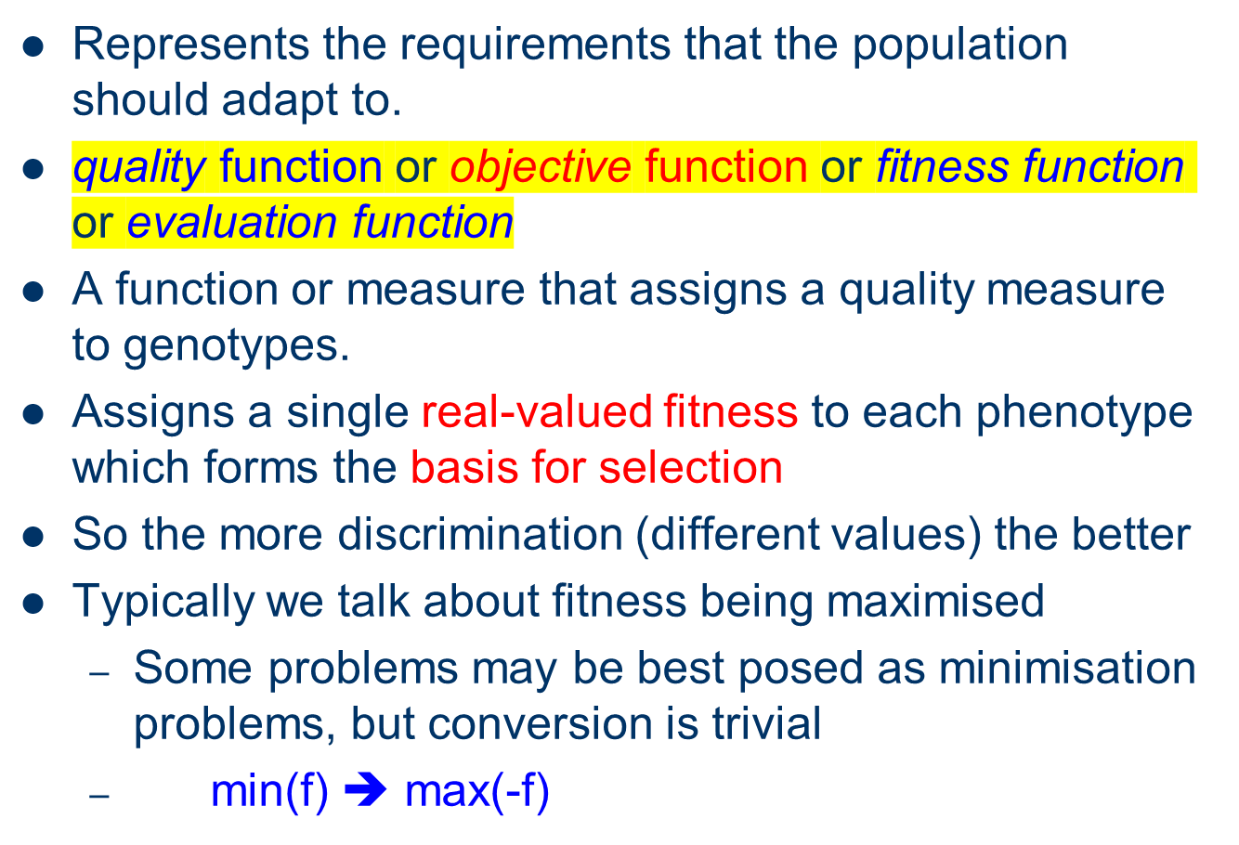
Evaluation (Fitness) Function

Slide 14
Population
Unit of evolution
Holds (representations of) possible solutions
Usually has a fixed size and is a multiset of genotypes
Some sophisticated EAs also assert an additional spatial structure on the population. (with distance measure or neighbourhood relation, etc)
Selection operators usually work at population level, taking whole population into account, i.e., reproductive probabilities are relative to current generation
Diversity of a population refers to the number of different solutions, indicating typically fitnesses (or even phenotypes / genotypes (note not the same thing))
Notes:
F(x1,x2)=x1^2+x2^2
X1=(1,1)→ 2
X3=(-1,-1)→ 2
Diversity might refer to different finesses, different phenotypes, or different genotypes

Slide 15
fitnesses ⬅ phenotypes ⬅ genotypes
fitnesses ➔ phenotypes ➔ genotypes
?
?
Notes:
Biology problem (妳跑很快，我跑很快，但2人可能是一男一女，染色體不同)
Search problem 會1對1

Slide 16
Parent (mating) Selection Mechanism
Parent (mating) selection is to distinguish among individuals, based on their quality, to allow the better individuals to become parents of the next generation.
Usually probabilistic (stochastic)
  High-quality solutions more likely to become parents than low-quality ones
  but not guaranteed
  even the worst in current population has non-zero probability of becoming a parent
This stochastic nature can aid escape from local optima; otherwise the whole search could become too greedy and get stuck in a local optimum.
Parent selection is responsible for pushing quality (fitness) improvements!

Slide 17
Variation Operators
to generate new candidate solutions
Usually divided into two types according to their arity (number of inputs):
  Arity 1 : mutation operators (突變)
  Arity >1 : Recombination operators (重組)
  Arity = 2 typically called crossover (交配)
There has been much debate about relative importance of recombination and mutation
  Nowadays most EAs use both
  Choice of particular variation operators is representation dependant, and perhaps problem dependent. eg. Boundary mutation

Slide 18
Mutation
Acts on one genotype and delivers another (slightly mutant, child or offspring)
Element of randomness is essential and differentiates it from other unary heuristic operators
Importance ascribed depends on representation and dialect (variant):
  Binary GAs – background operator responsible for preserving and introducing diversity; fill the pool with fresh blood.
  EP for FSM’s/ continuous variables – the only search operator
  GP – hardly used (using recombination operator only)
May guarantee connectedness of search space and discover the global optimum
“Jump” everywhere!!
Notes:
He ascribed his good health to proper diet and exercise
0000-→ 1000，由0跳到8
heuristic operators➔ A*, if cost ???, then ???

Slide 19
Recombination
Merges information from parents into offspring
Choice of what information to merge is stochastic
Differently in EC dialects:
  GA: main search operator
  GP: the only variation operator
  EP: never used
Higher arity (more than 2 parents) is possible, though no biological equivalent.
Most offspring may be worse, or the same as the parents, and some with improved characteristics
Hope is that some are better by combining elements of genotypes that lead to good traits.
Notes:
農作物、牲畜改良都是recombination
Plants or livestock

Slide 20
Variation operator is representation dependent.
Ex:
crossover operation for permutation representation
mutation operation for permutation representation
mutation for bit-string and tree-like structure
➔ Variation operator is, perhaps, problem dependent!

Slide 21
Survivor Selection
EC population is generally constant
Which individuals are allowed in the next generation?
Most EAs use fixed population size so need a way of going from (parents + offspring) to next generation
a.k.a. (also known as) replacement or replacement strategy
Often deterministic (vs stochastic for parent selection)
  Fitness based: e.g., rank (parents+offspring) and take best
  Age based: make as many offspring as parents and delete all parents
EX: Pop=100, survivor selection for 2 children or 500 children
Elitism is generally adopted

Slide 22
Initialisation / Termination
Initialisation usually done at random,
  Need to ensure even spread and mixture of possible allele values
  Can include existing solutions, or use problem-specific heuristics, to “seed” the population
Termination condition checked every generation
  Reaching some known (hoped for) fitness, eg. Benchmark functions
  Reaching some maximum allowed number of generations (Max Gen.)
  Reaching some maximum allowed number of function evaluations (FE)
  Reaching some minimum level of diversity (population diversity drops under a threshold level)
  Reaching some specified number of generations without fitness improvement
  Maximal allowed CPU time elapses (Time constraint)

Slide 23
Treatment for a specific EA:
  Representation
  Variation (recombination & mutation)
  Selection
  (initialization and termination are not considered, because they are not ‘dialect’ specific!)

Slide 24
Example: the 8-queens problem (yielding N-queens problems)
Place 8 queens on an 8x8 chessboard in such a way that no 2 queens can check each other!
Conventional method: incremental!
➔ needs backtracking (If there is no feasible position for the (n+1)th queen, the nth is moved to another position)
Notes:
If there is no feasible position for the (n+1)th queen, the nth is moved to another position-→ backtracking

Slide 25
Representation:
Phenotype:
a board configuration
Genotype:
a permutation of
the numbers 1 - 8
Obvious mapping
1
3
5
2
6
4
7
8

Slide 26
Fitness evaluation:
Quality of a phenotype:
    number of checking queen pair
    the lower the better (0 is a good solution)
Penalty of a configuration:
    the sum of the penalties of all queens.
Note: penalty is to be minimized
Fitness of a configuration (to be maximized)
    inverse penalty to be maximized

Slide 27
Recombination:
Combining two permutations into two new permutations:
choose random crossover point
copy first parts into children
create second part by inserting values from other parent:
  in the order they appear there
  beginning after crossover point
  skipping values already in child
1
3
5
2
6
4
7
8
1
3
5
4
2
8
7
6
8
7
6
5
4
3
2
1
8
7
6
2
4
1
3
5

Slide 28
Mutation:
Small variation in one permutation, e.g.:
swapping values of two randomly chosen positions,
1
3
5
2
6
4
7
8
1
3
7
2
6
4
5
8
➔ violations do not occur!
Notes:
Horizontal and vertical violations do not occur!

Slide 29
Selection:
Parent selection:
  Pick 5 parents and take best two to undergo crossover & mutation
Survivor selection (replacement)
  When inserting a new child into the population, choose an existing member to replace by:
  sorting the whole population (100+2) by decreasing fitness
  enumerating this list from high to low
  Deleting the worst two.
Notes:
Selection 有很多作法: 例如 =0.8，選0.8*5=4，有兩對去crossover
Consider crossover only in this example. Mutation can be considered as well for variation.

Slide 30
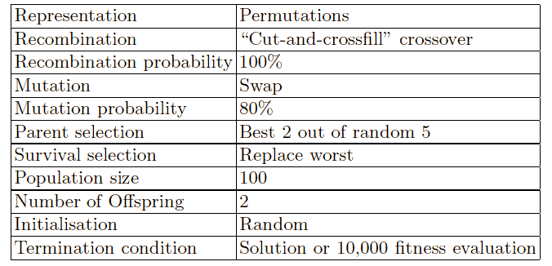
8 Queens Problem: summary
Note that it is only one of the possible
set of choices of operators and parameters

Slide 31
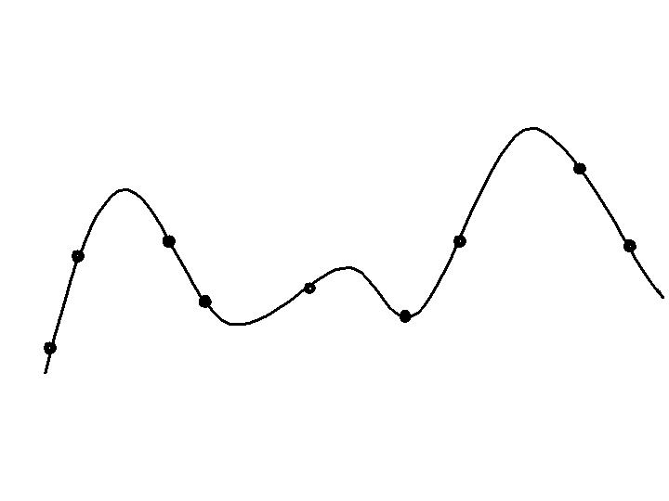
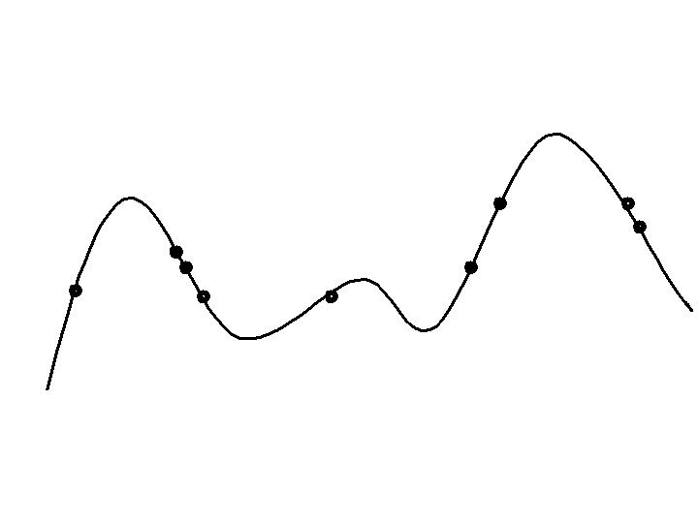
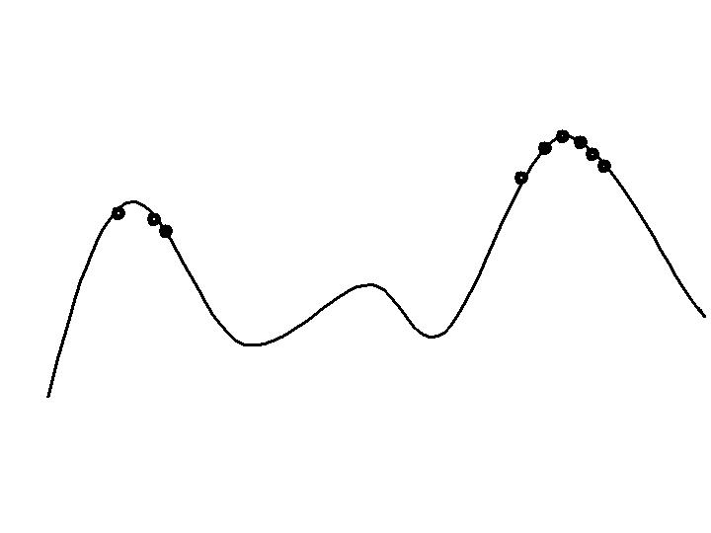
Typical behavior of an EA
Phases in optimizing on a 1-dimensional fitness landscape
Early phase:
random population distribution
Mid-phase:
population arranged around/on hills
Abandon low-fitness regions and
climb the hill
Late phase:
population concentrated on high hills
Around sub-optima and global optima

Slide 32
Exploration: 探索搜尋
  The generation of new individuals in as yet untested regions of the search space
Exploitation: 鑽探搜尋
  The concentration of the search in the vicinity (附近) of known good solutions
Trade-off between the two
  Too much exploration ➔ inefficient search
  Too much exploitation ➔ pre-mature convergence
Pre-mature convergence is the well-known effect of losing population diversity too quickly and getting trapped in a local minimum.

Slide 33
Typical run: progression of fitness
Best fitness in population
Time (number of generations)
Typical run of an EA shows so-called “anytime behavior”
The search can be stopped at any time to have some solutions, even it is sub-optimal.

Slide 34
Are long runs beneficial?
Progress in 2nd half
Best fitness in population
Progress in 1st half
Time (number of generations)
Answer:
- it depends how much you want the last bit of progress
- it may be better to do more shorter runs
- it may not be worthwhile to allow a very long run

Slide 35
Is it worth expending effort on smart initialization?
Best fitness in population
F
F: fitness after smart initialization via heuristics
T: time needed to reach level F after random initialization
T
Time (number of generations)
Answer: it depends:
- possibly, if good solutions/methods exist.
- extra effort questionable? Typically a few
generations are enough to reach this level.
- generally unnecessary!

Slide 36
Evolutionary Algorithms in Context
There are many views on the use of EAs as robust problem solving tools (robust problem solver)
Random search, problem-specific tools, or EA?
A problem-specific tool may:
  perform better than a generic (通用型) search algorithm
  have limited utility (for a specific problem only)
  not do well on all instances
Goal is to provide robust tools that provide:
  evenly good performance
  over a range of problems and instances
Mathematical optimization:
https://en.wikipedia.org/wiki/Mathematical_optimization#Iterative_methods
Notes:
Mathematical optimization
https://en.wikipedia.org/wiki/Mathematical_optimization#Iterative_methods
Newton's method
steepest descent

Slide 37
EAs as problem solvers:
Goldberg’s 1989 view
Special, problem tailored method
Evolutionary algorithm
Performance of methods on problems
Random search
Scale of “all” problems

Slide 38
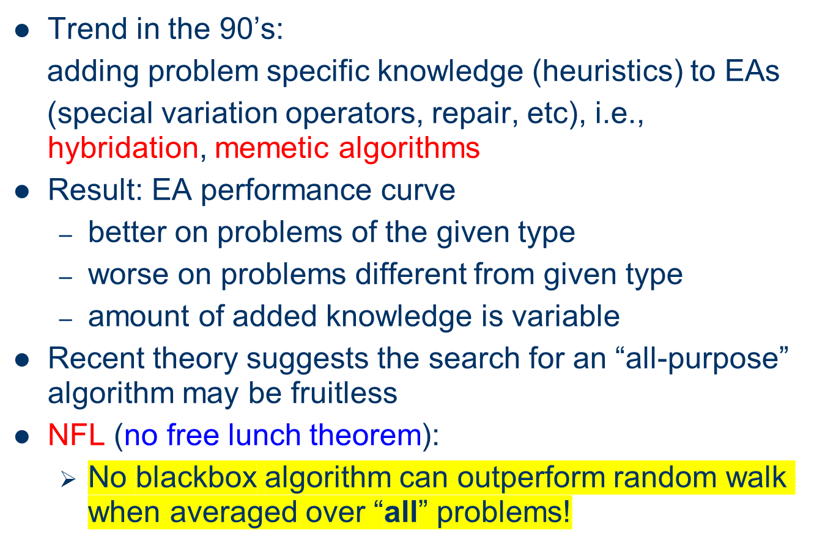
EAs and domain knowledge
Notes:
https://ithelp.ithome.com.tw/articles/10227251
模因演算法(Memetic Algorithm, MA)是遺傳演算法的延伸
中文又叫做文化基因演算法、瀰集演算法。MA是根據文化的演化概念所發展出來了多點搜尋法，利用全域搜尋結合區域搜尋來求解。

Slide 39
Michalewicz’ 1996 view
EA 4
EA 2
EA 3
EA 1
Performance of methods on problems
P
Scale of “all” problems
➔ Better on problems of the given type;
Worse on problems different from given type.

Slide 40

EC and Global Optimisation
Global Optimisation: search for finding best solution x* out of some fixed set S, such that
Deterministic approaches
  e.g. complete enumeration (exponentially long time) 窮舉法
  box decomposition (branch and bound etc)分支界定法
  Guarantee to find x* , but may run in super-polynomial time
Heuristic Approaches (generate and test)
  rules for deciding which x ∈ S to generate and test next
  no guarantees that best solutions found are globally optimal
Notes:
分支界定法:
http://episte.math.ntu.edu.tw/articles/mm/mm_11_3_02/page2.html
An algorithm is said to take superpolynomial time if T(n) is not bounded above by any polynomial, i.e., exponential time

Slide 41
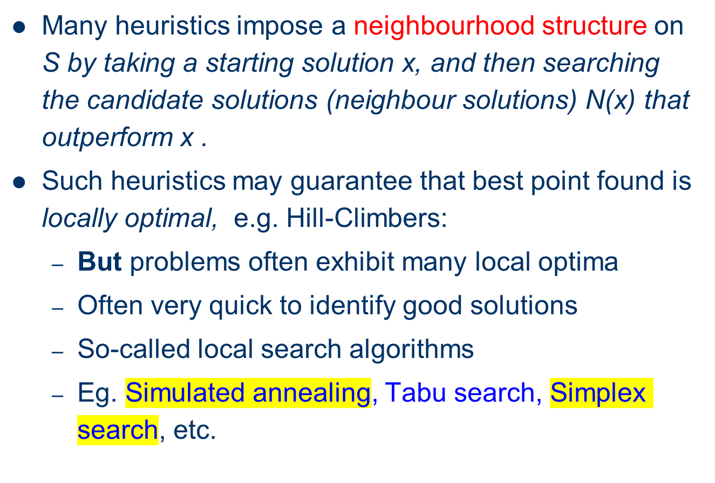
EC and Neighbourhood Search

Slide 42
EAs are distinguished by:
Use of population,
Use of multiple, stochastic search operators
Especially variation operators with arity >1
Stochastic selection

